Slide 1

Exploring IllustrisTNG simulations to derive observationally comparable star formation rates (and metallicities?)
TNG_workshop.py
title.info
www.tng-project.org
< Bryanne McDonough & Olivia Curtis >
Request API key ->

Slide 2
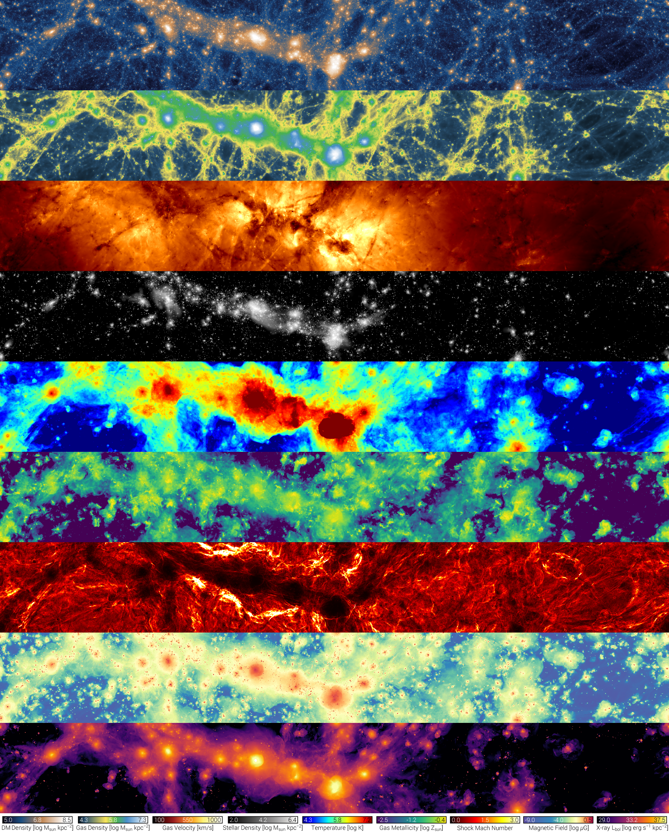
Dark matter column density
Gas column density
Gas velocity
Stellar column density
Temperature
Gas metallicity
Shock Mach number
Magnetic field
X-ray luminosity

Slide 3
Learning goals {
TNG_workshop.py
Learning_goals.info
Understand the scope and purpose of the Illustris TNG simulation suite, including available simulations, observational tensions, and limitations to the simulation.
Navigate and interpret essential TNG data products, such as Halo/Subhalo catalogs, supplementary catalogs, merger trees, and particle data.
Learn to access and manipulate TNG data using the TNG API, through both browser-based exploration tools and Python API requests.
Derive observationally comparable parameters relating to star formation from TNG galaxies, including calculating global and local (resolved) star formation rates and determining luminosity-weighted ages.
Gain practical skills in translating simulation data into meaningful astrophysical insights.
Apply acquired knowledge and skills to conduct research using Illustris TNG data.
}

Slide 4
Table Of ‘Contents’ {
01
02
03
TNG_workshop.py
contents.info
About IllustrisTNG
< Suite of magnetohydrodynamic cosmological simulations >
Data Specifications
< Distinguish the different types of data available >
Practical Exercise
< Your turn! Practice in Jupyter Notebooks >
}

Slide 5
01 {
[About IllustrisTNG]
TNG_workshop.py
about_IllustrisTNG.info
< Suite of magnetohydrodynamic cosmological simulations >
}

Slide 6
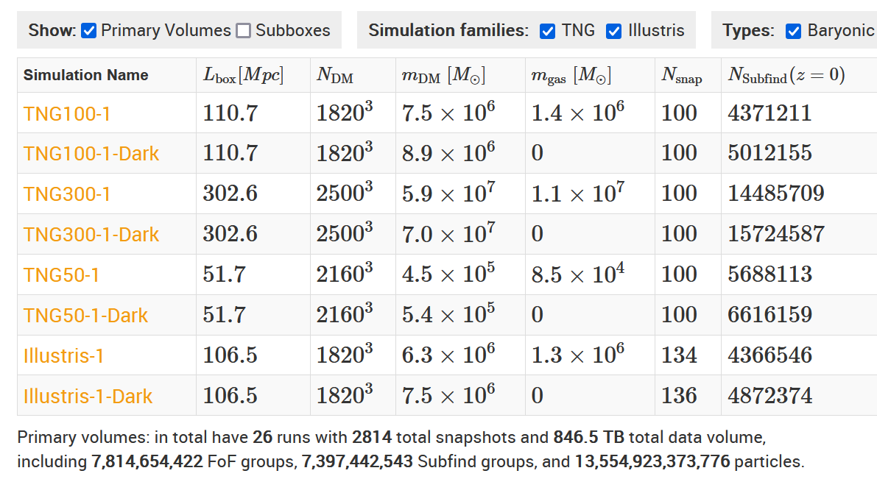
Available Simulations; {
TNG_workshop.py
about_IllustrisTNG.info
}

Slide 7
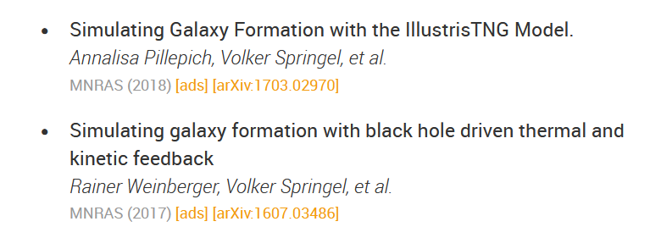
SF and AGN Feedback modeling
TNG_workshop.py
about_IllustrisTNG.info
# Stars form stochastically in gas cells above a density threshold of 0.13 cm⁻³
# Model includes gas cooling, stellar evolution, gas recycling, chemical enrichment, SNe-driven kinetic stellar feedback
# SMBH: seeding, accretion, merging, feedback
AGN Feedback
High-Accretion
“Quasar Mode”
Low-Accretion
“Kinetic Mode”
Thermal energy injected into surrounding gas
Kinetic energy injected into surrounding gas
← methods papers

Slide 8
Calibration and Validation
TNG_workshop.py
about_IllustrisTNG.info
Calibration:
# reproduce observed galaxy properties at z=0, including:
# galaxy stellar mass function and stellar-to-halo mass relation
# total gas mass content within virial radius of massive groups
# stellar mass – stellar size and BH – galaxy mass relation
# at z<10, the shape of cosmic SFR density
Validation:
# comparable to observations in several regimes not tuned to, incl:
# radial distribution of SF properties
# galaxy populations, galactic structural and stellar population properties
# red sequence and blue cloud of galaxies (Nelson+ 2018a)
# galaxy stellar mass functions up to z∼4 (Pillepich+ 2018b)
# population of quenched galaxies both at low (Weinberger+ 2018) and high redshift (Hazouhit+ 2018)
Public Data Access Overview / Background and Important Details

Slide 9
Cautions
TNG_workshop.py
about_IllustrisTNG.info
Need to balance desire for large sample size with necessary spatial resolution
Minimum spatial resolution set by gravitational softening radius
Comparison with observations requires careful consideration
Some possible tensions with observations listed in background information
Notes:
# TNG galaxies may have a weaker connection between galaxy morphology and color than observed at z∼0, reflected in a possible excess of red disk-like galaxies in the simulations (Rodriguez-Gomez+ 2018, although see Tacchella+ 2019)
# TNG galaxies exhibit a somewhat sharper trend than observations in quenched fraction vs. galaxy stellar mass for M⋆∈10¹⁰⁻¹¹M⊙ (Donnari+ 2019 and Donnari+ 2020b), and similarly in the relation between sSFR and M_{BH} at low redshift (Terrazas+ 2020).
# locus of the galaxy star-forming main sequence is below the face-value observed SFMS at 1≲z≲2, modulo known inconsistencies with e.g. the observed stellar mass function (Donnari+ 2019a).
# H2 mass content of massive TNG galaxies at z=1−3 may be lower than implied by ALMA observations (Popping+ 2019) and sub-mm galaxy demographics (Hayward+ 2020).

Slide 10
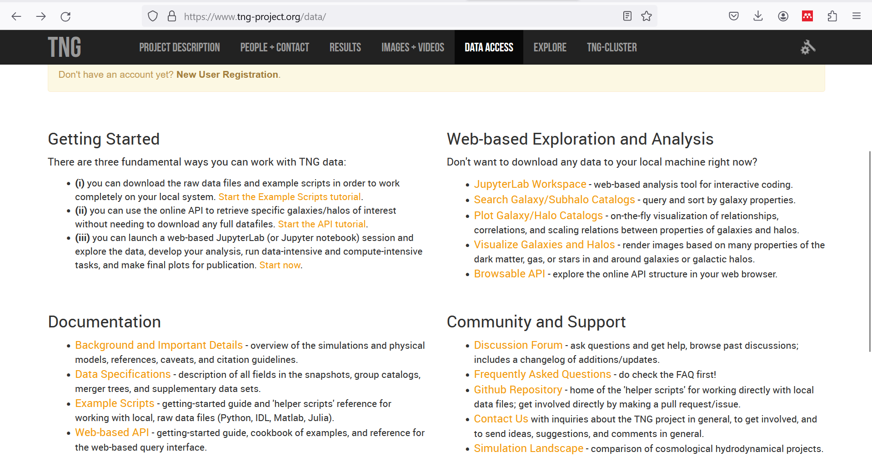
What Is this ‘Topic About ?’ {
forbeginners.html
workshop.css
Languages
Html
60%
Css
40%
< Mercury is the smallest planet in the entire Solar System >
< The Earth is the only one that harbors life in the Solar System >
Create a web page
Venus has a nice name
Mars is a cold place
Jupiter is a gas giant
}
Programming Language
Notes:
Explore data access page: https://www.tng-project.org/data/

Slide 11
02 {
[Data Specifications]
TNG_workshop.py
data_specifications.info
< Distinguish the different types of data available >
}

Slide 12
Data Types {
TNG_workshop.py
data_specifications.info
group catalogs:
Halo (FoF group) and subhalo (galaxy) properties
snapshots:
Particle-level data
merger trees:
Track galaxy properties across snapshots
supplementary data catalogs:
Data derived by other users
}
Notes:
Jupyter Notebook #1

Slide 13
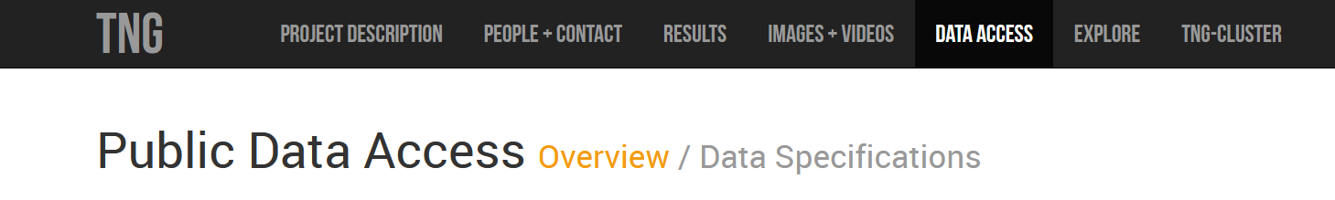
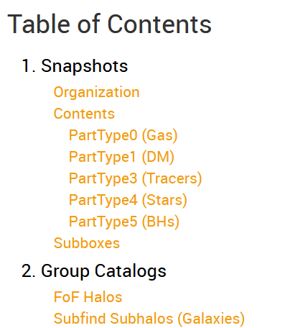



class group_catalogs:
TNG_workshop.py
data_specifications.info
# Halo (FoF group) and subhalo (galaxy) properties for each snapshot
Learn about available properties, units, etc:
Examples:

Slide 14
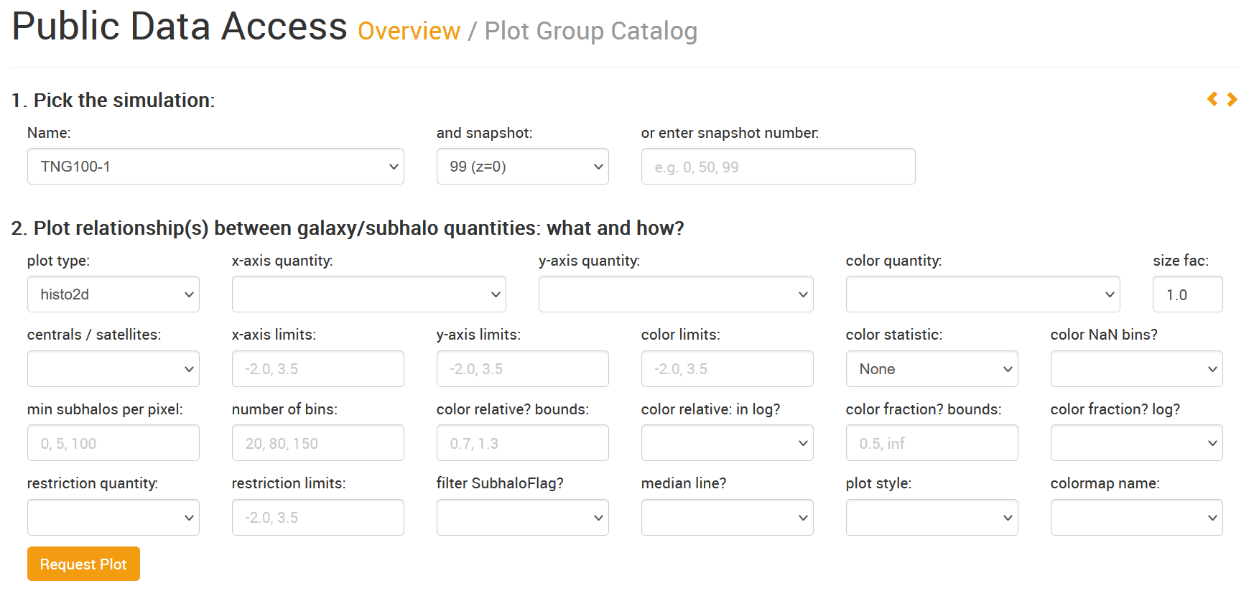
class group_catalogs:
TNG_workshop.py
data_specifications.info
def group_vis_tool():

Slide 15
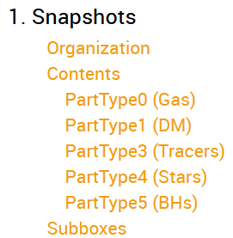
class snapshots:
TNG_workshop.py
data_specifications.info
# A full snapshot includes all particle data at a given timestep
# These files can be LARGE, but you’ll rarely need every field
# Instead, fetch only the particle parameters you want, and/or utilize cutouts
Learn about available properties, units, etc:
Cutouts = files that contain all particles bound to a halo/subhalo
Useful for:
Examining resolved properties/ profiles of galaxies/halos
Obtaining parameters not included in group catalogs

Slide 16
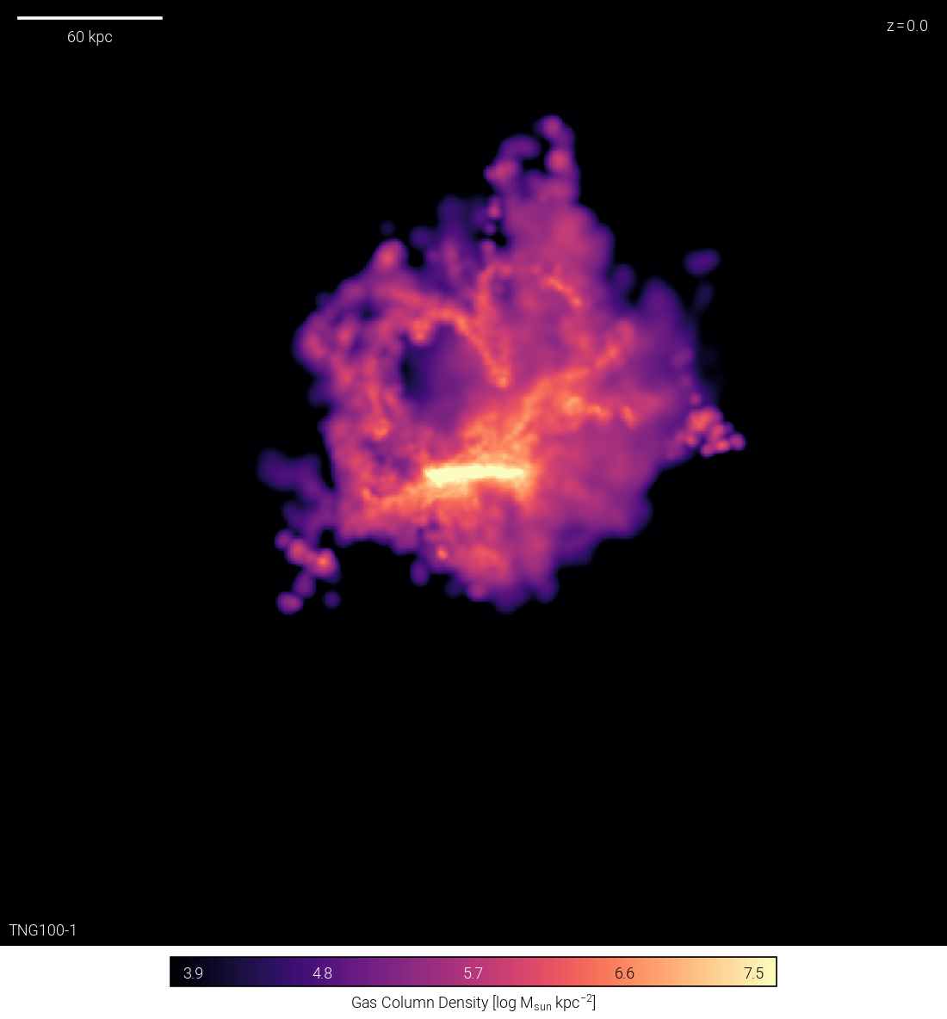
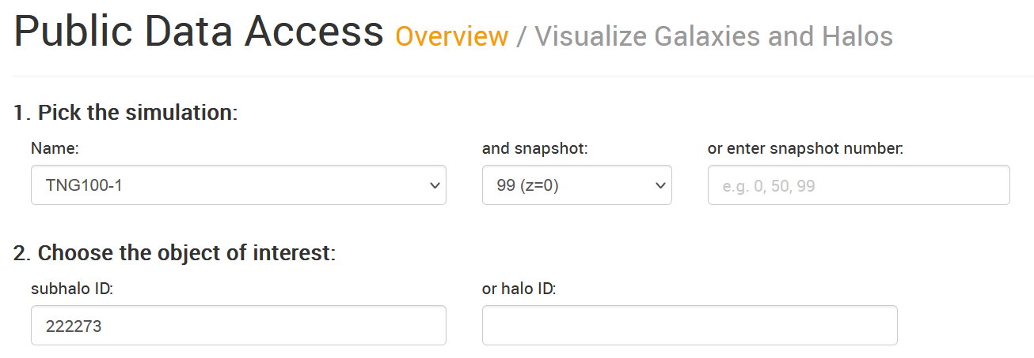
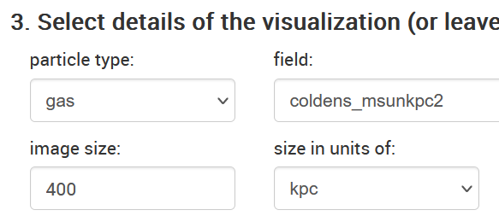
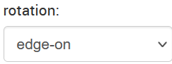
class snapshots:
TNG_workshop.py
data_specifications.info
def cutout_vis_tool():

Slide 17
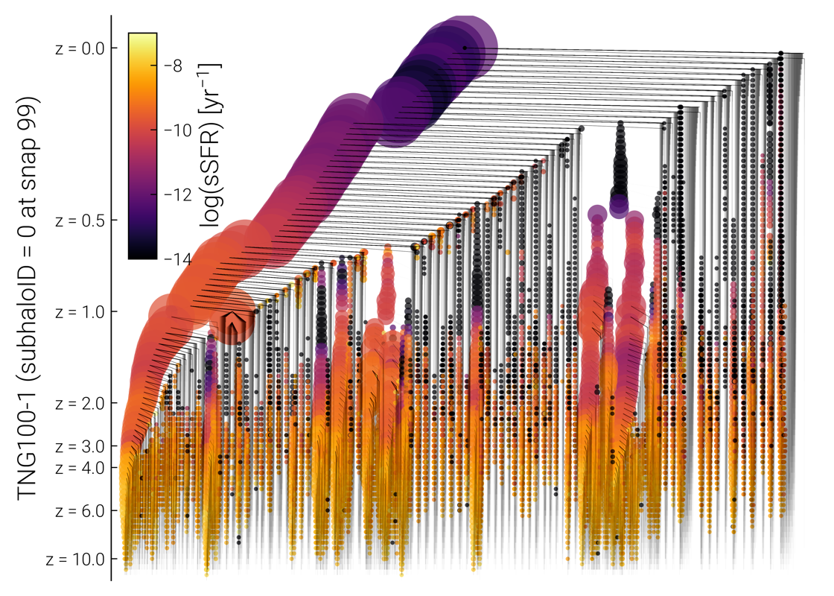
class merger_trees:
TNG_workshop.py
data_specifications.info
# merger trees trace a subhalo through previous snapshots
# contain group catalog fields as a function of snapshot
# can learn more about the trees in Data Specifications
def merger_vis_tool():
Useful for:
Determining history of a subhalo
Change in properties since a given redshift
Visualization tool allows by-eye analysis of merger history
Example visualization >>
Most massive subhalo in TNG100
Size of circle corresponds to subhalo mass
Merger tree visualization: https://www.tng-project.org/api/TNG100-1/snapshots/99/subhalos/0/sublink/tree.png

Slide 18
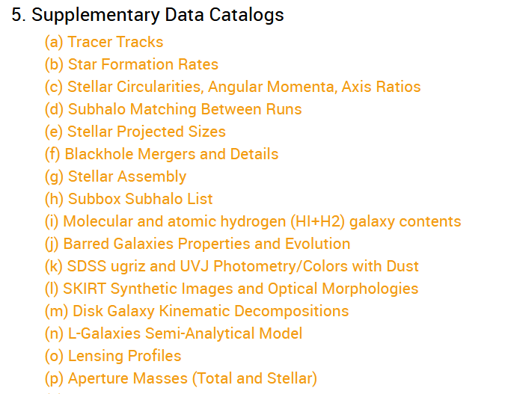
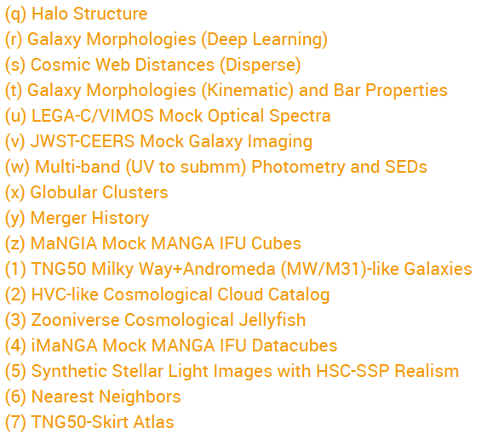
class supplementary_data_catalogs:
TNG_workshop.py
data_specifications.info
# data products derived from simulation data by TNG team and users
# 33 now available and new catalogs added regularly!

Slide 19
Troubleshooting; {
TNG_workshop.py
data_specifications.info
Problems accessing data with API
< Print URL in get(), check for accuracy, follow in browser. >
Odd outlier(s)
< Check system with Visualize Galaxies and Halos tool or data/vis in browser API >
Other
< Check the FAQ, reach out for help! >
}

Slide 20
03 {
[Practical Exercises]
TNG_workshop.py
practical_exercises.ipynb
< Your turn! Practice in Jupyter Notebooks >
}

Slide 21
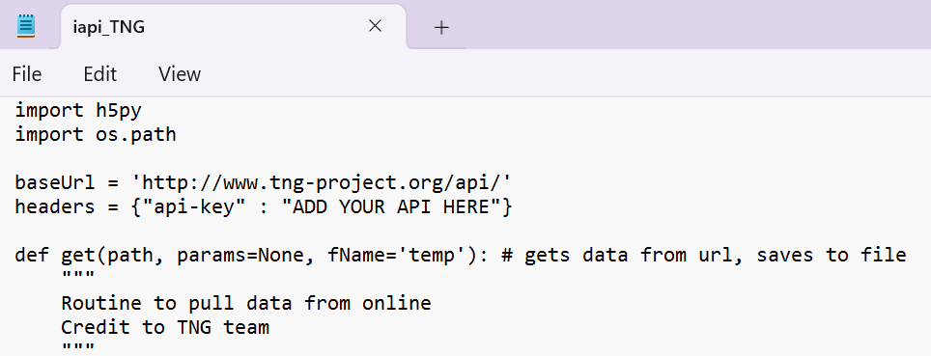
Update your API key!
TNG_workshop.py
practical_exercises.ipynb

Slide 22
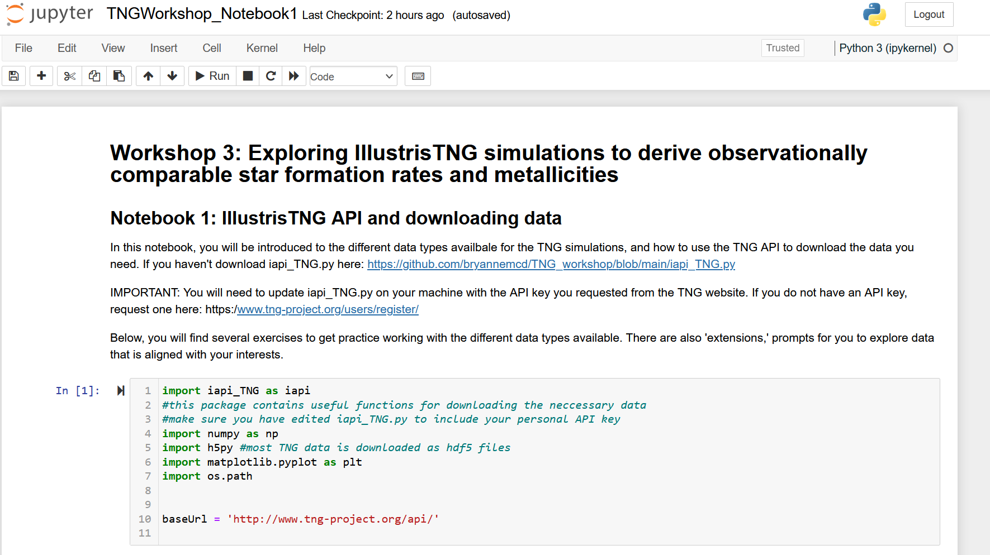
Your turn: Use the TNG API to download simulation data: Notebook 1
TNG_workshop.py
practical_exercises.ipynb
Remember to update iapi_TNG.py with your TNG API key!!!
Didn’t request an API key ahead of time? Follow the link to the github repository in the workshop Slack channel.
Already done with Notebook 1? Move on to either Notebook 2 or 3 OR review other TNG data available that you may want to use
Don’t be afraid to ask the facilitator or your table for help!

Slide 23
Your turn{
<Notebook 2>
<Notebook 3>
TNG_workshop.py
practical_exercises.ipynb
< Work on Notebook 2 or 3, depending on your interest>
Plot the global SF main sequence
Perform a ‘ridge line’ fit of the SMFS
Investigate impact of choices on SFMS slope
Convert scale factors to lookback times
Compute time-averaged SFRs
Compute luminosity-weighted ages
Done? Work on the other notebook, or brainstorm how you could use TNG for your work.
}
Don’t be afraid to ask the facilitator or your table for help!

Slide 24
Thanks; {
TNG_workshop.py
thanks.info
Thank you to the TNG team and Dylan Nelson for the simulation data, API tools, and helpful documentation.
Thanks to Olivia Curtis for improving the notebooks
‘Do you have any questions?’
bnmcd@bu.edu
}

